Slide 1
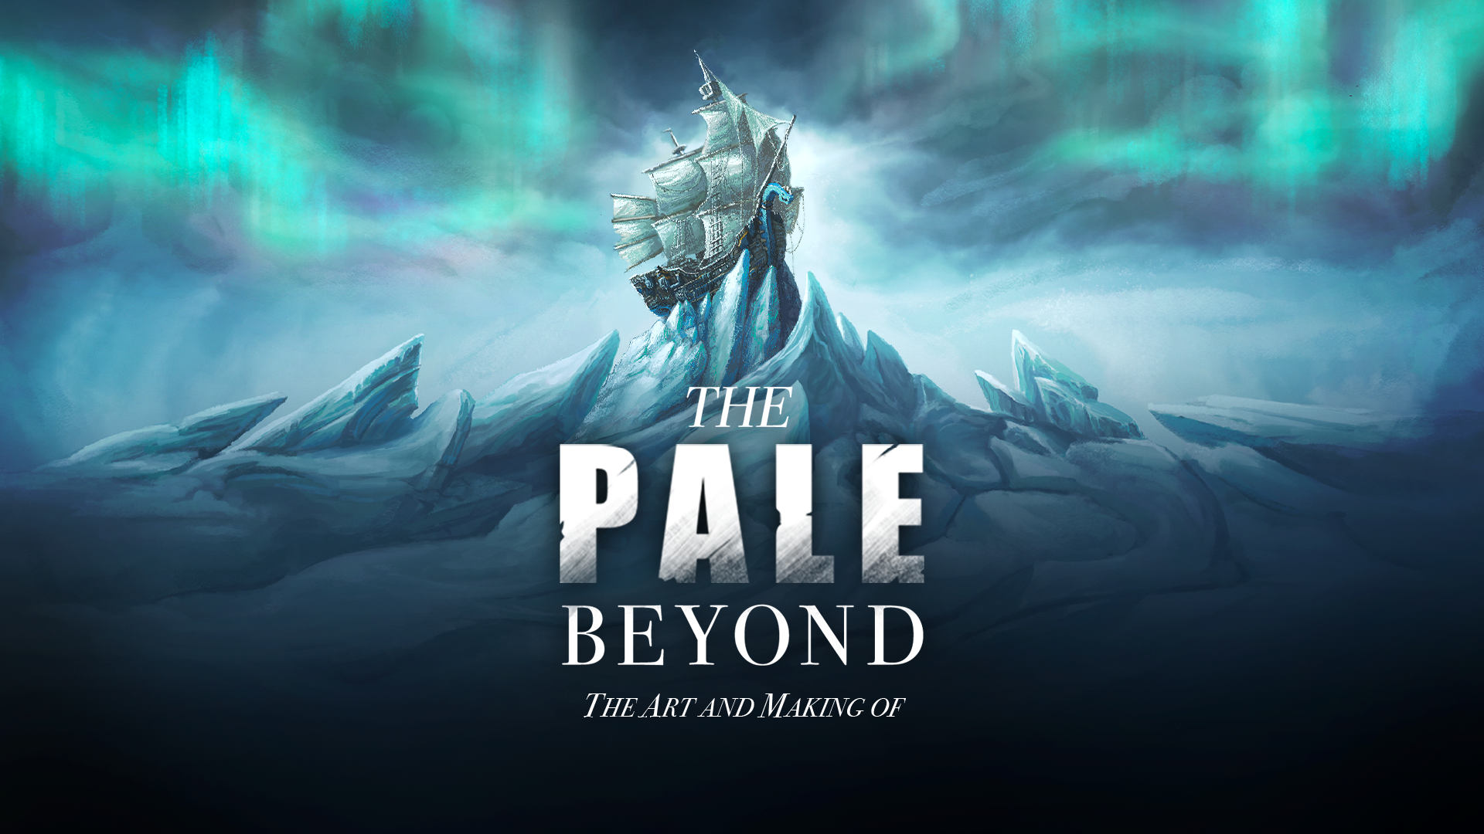

The Pale Beyond
Rover Vos
Rover Vos 2023
Image – (Bellular Studios, 2023)

Slide 2


Slide 3
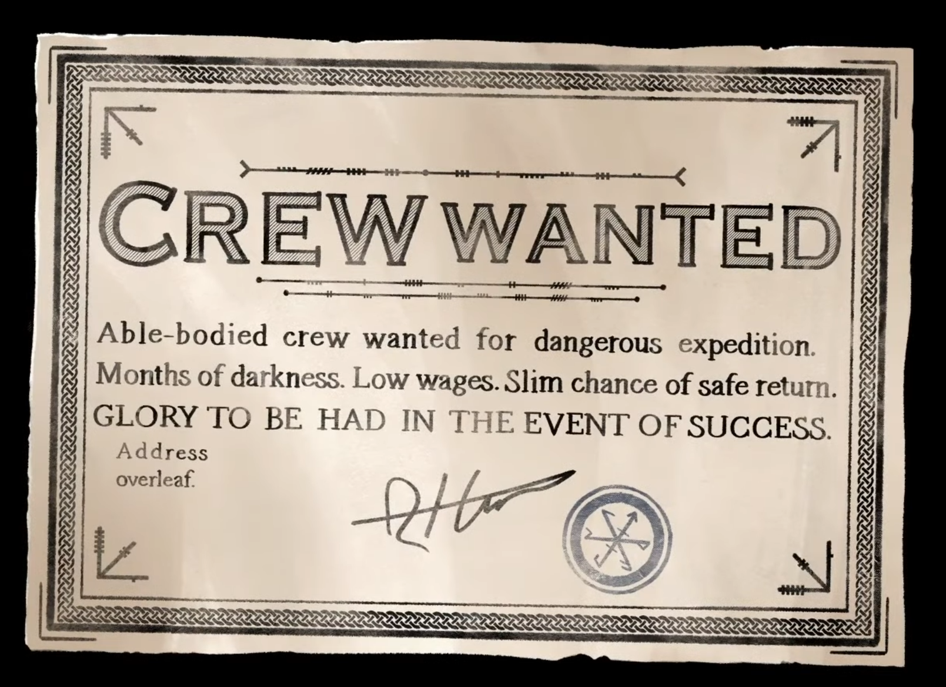
WOW AFFECT
In game screenshot self-made

Slide 4
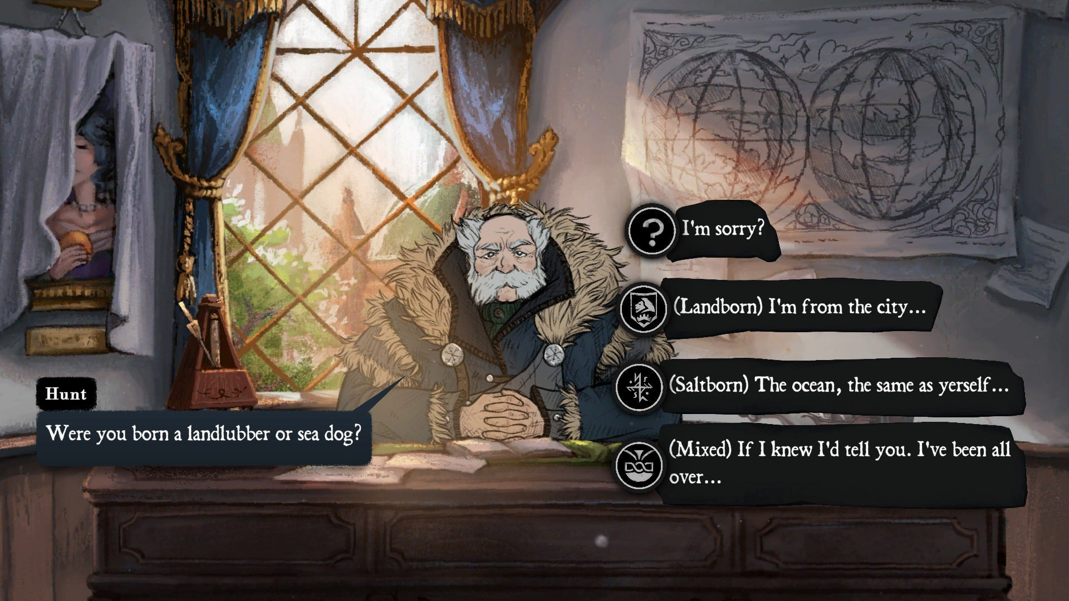
In game screenshot self-made

Slide 5
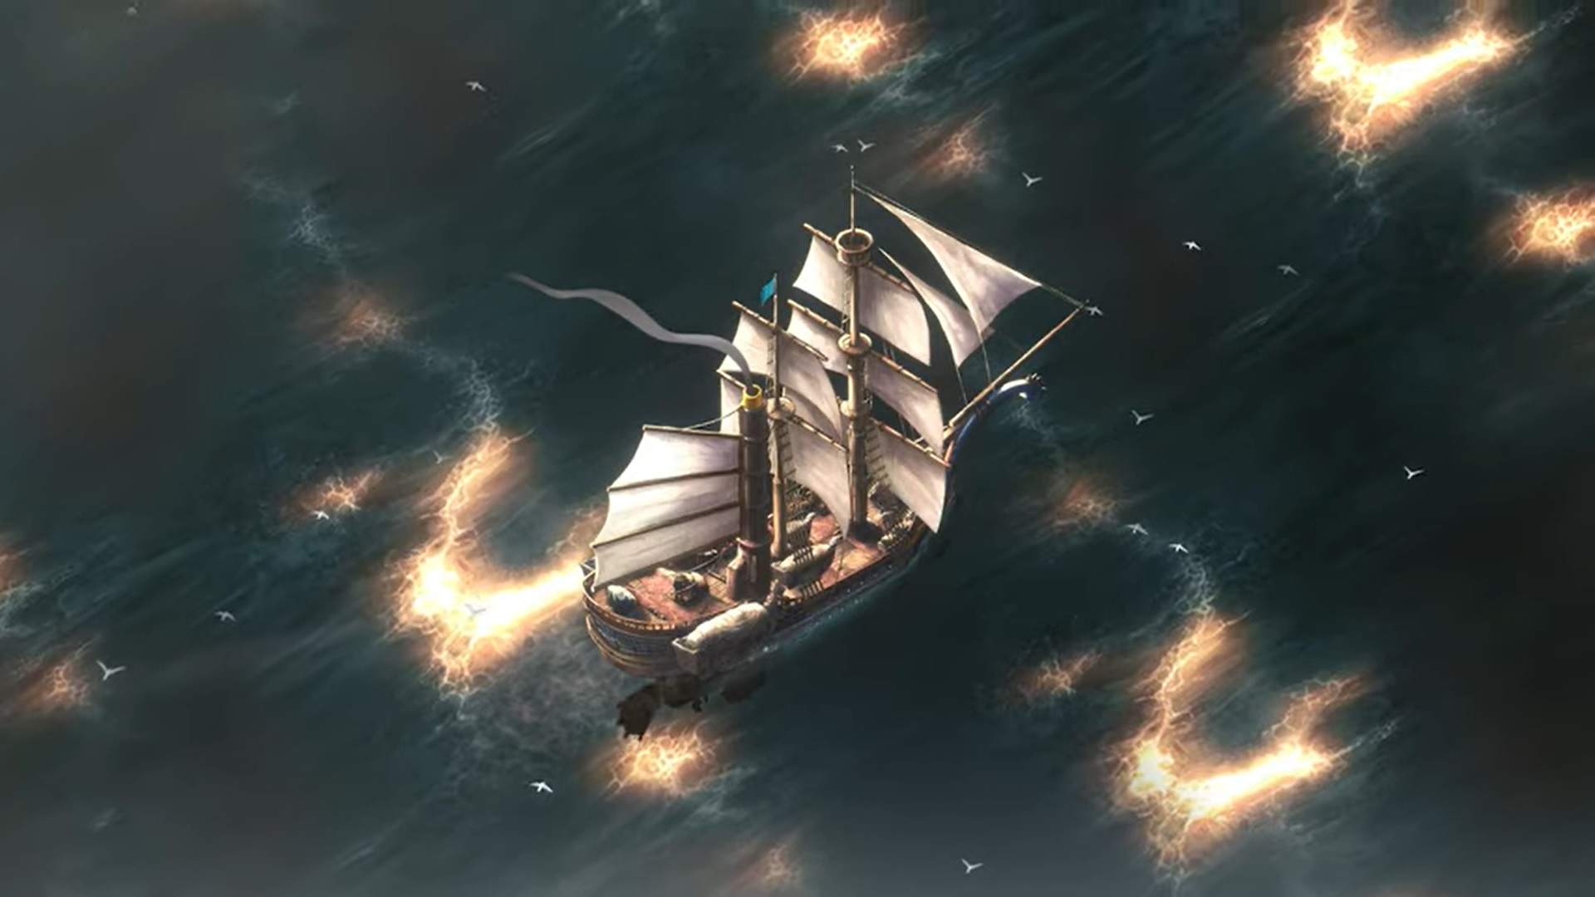
In game screenshot self-made

Slide 6
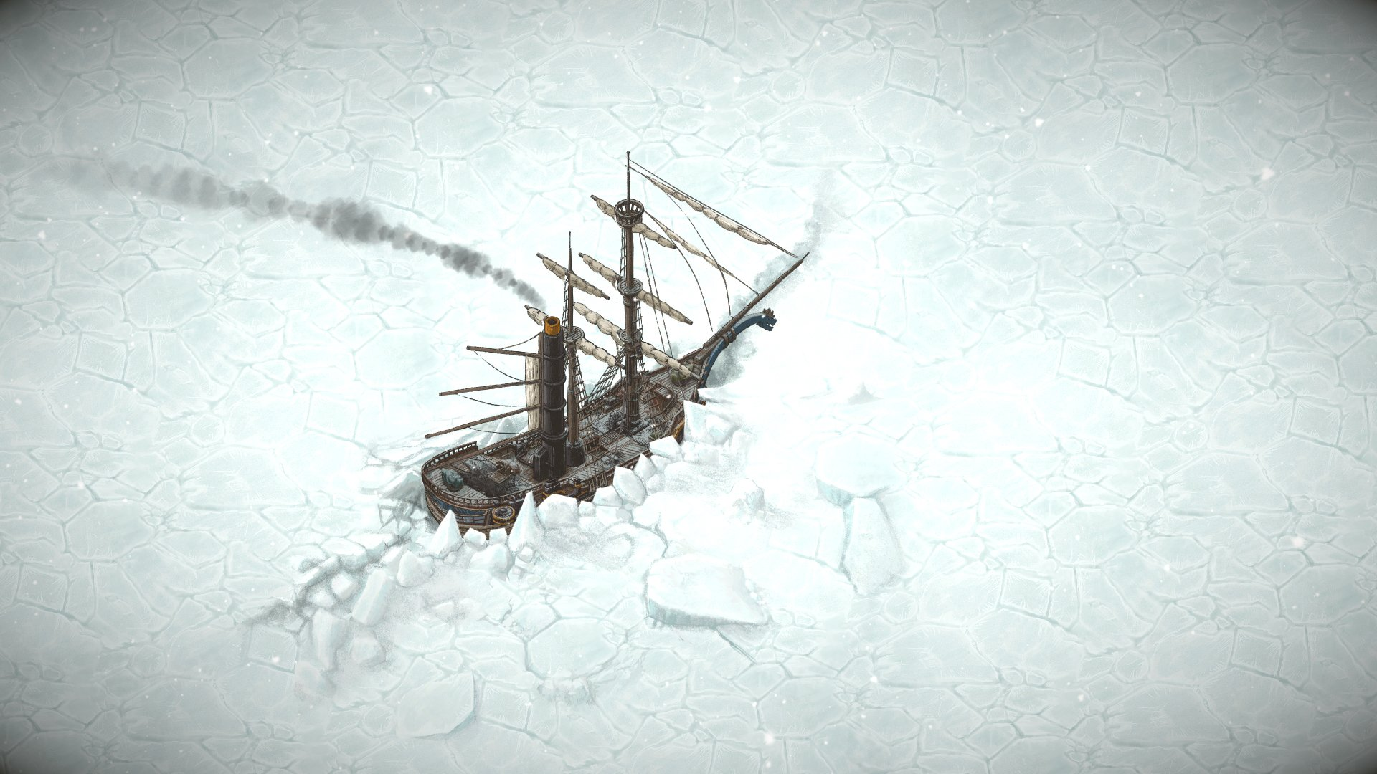
In game screenshot self-made

Slide 7
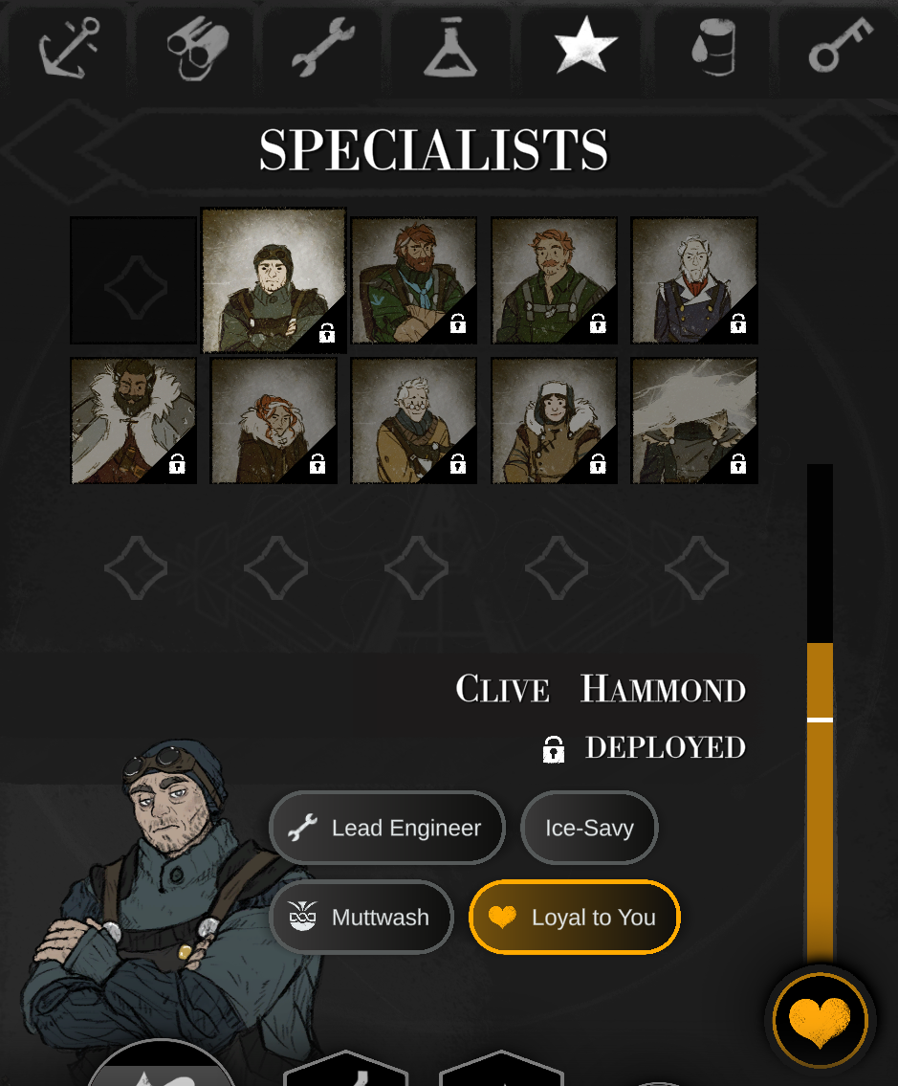
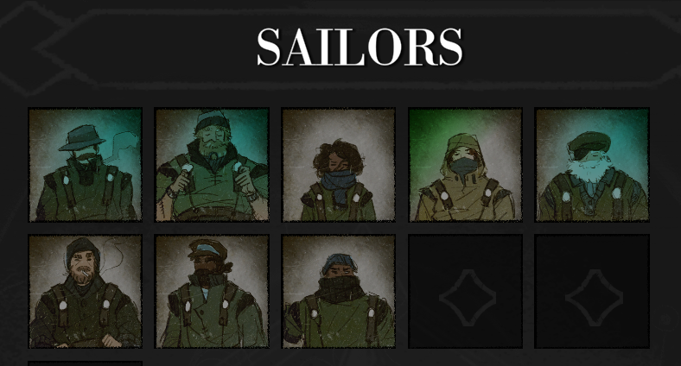
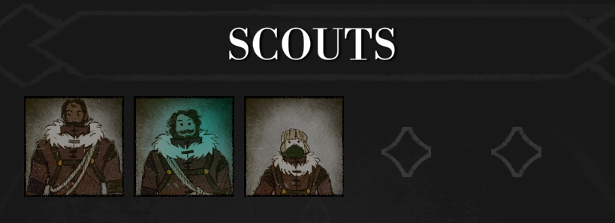


The crew
In game screenshots self-made

Slide 8
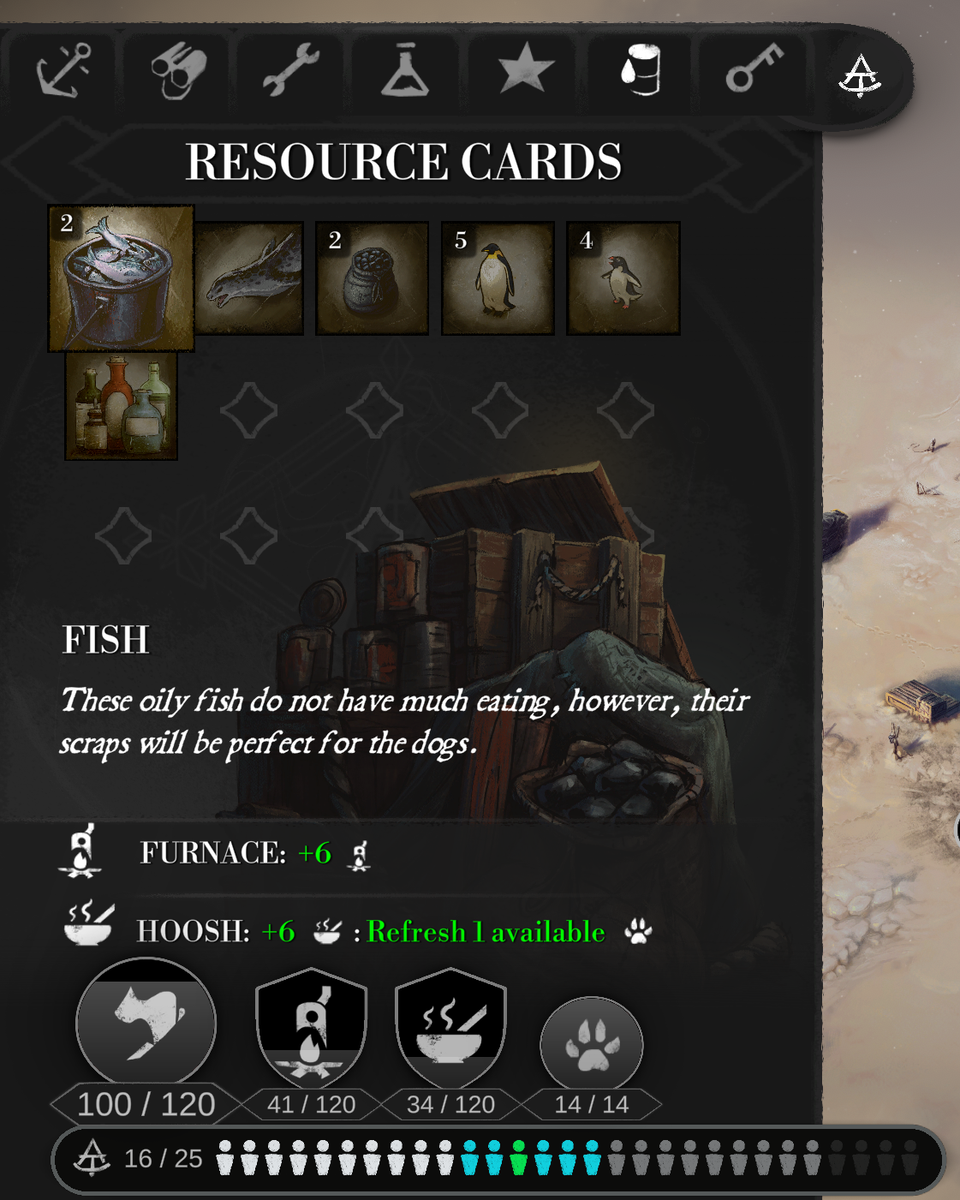
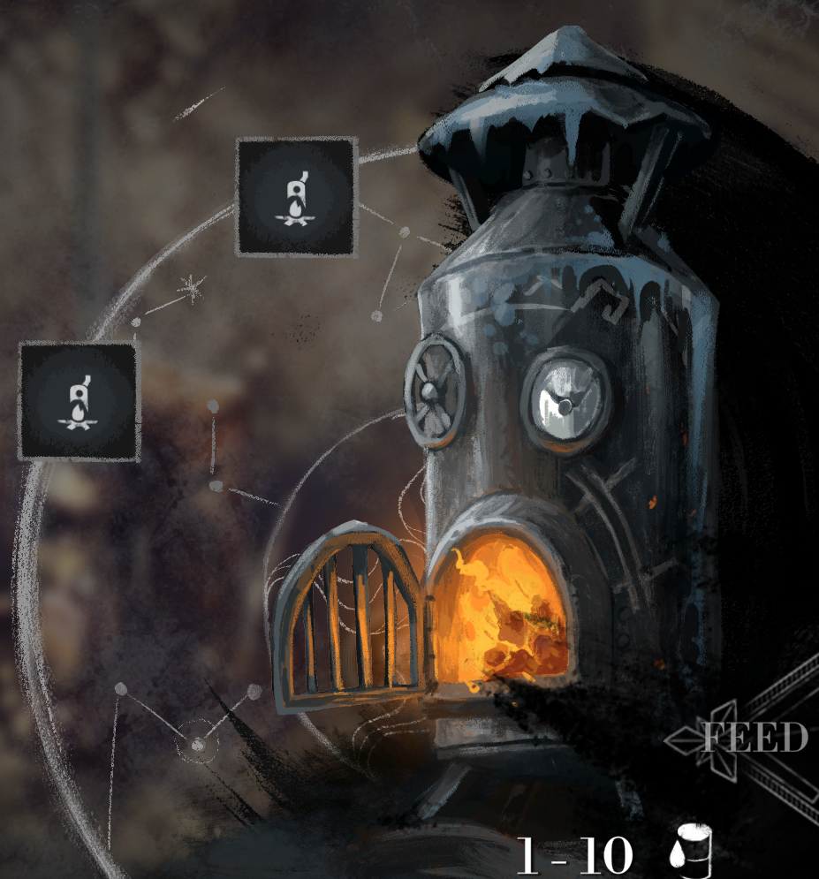
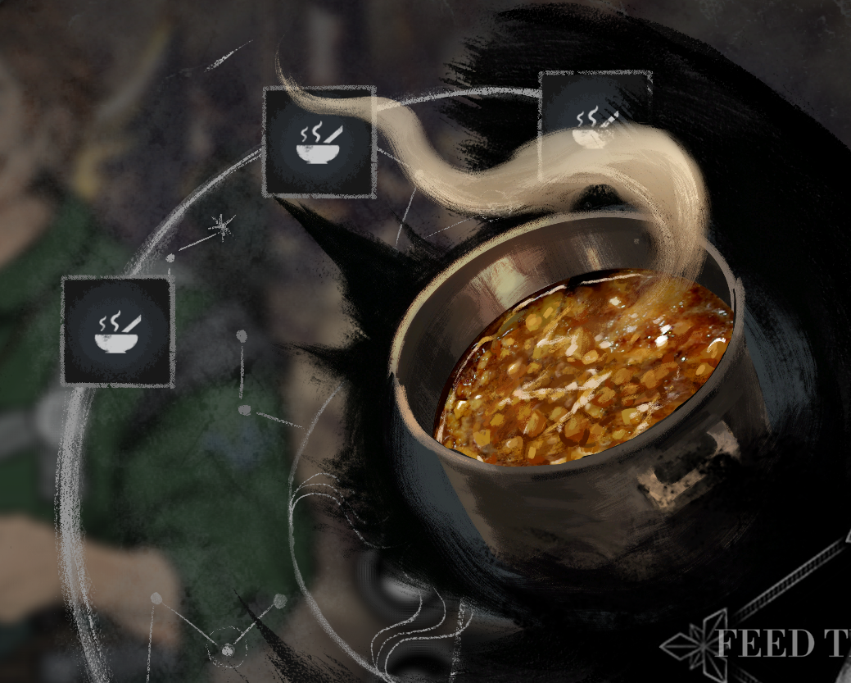
Resources
In game screenshots self-made

Slide 9
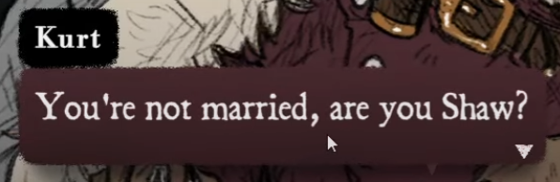
Robin Shaw?
In game screenshot self-made

Slide 10
Affect of identity
Identity increases enjoyment (Hefner, 6)

Slide 11
Is (a good)personal identity required for an affective relationship with games?

Slide 12
My Affective Journey in The Pale Beyond

Slide 13
Session 0: Why The Pale Beyond?

Slide 14
“Affect pertains to “raw” experience”
(Massumi, 207)

Slide 15
Session 1: The save system?

Slide 16
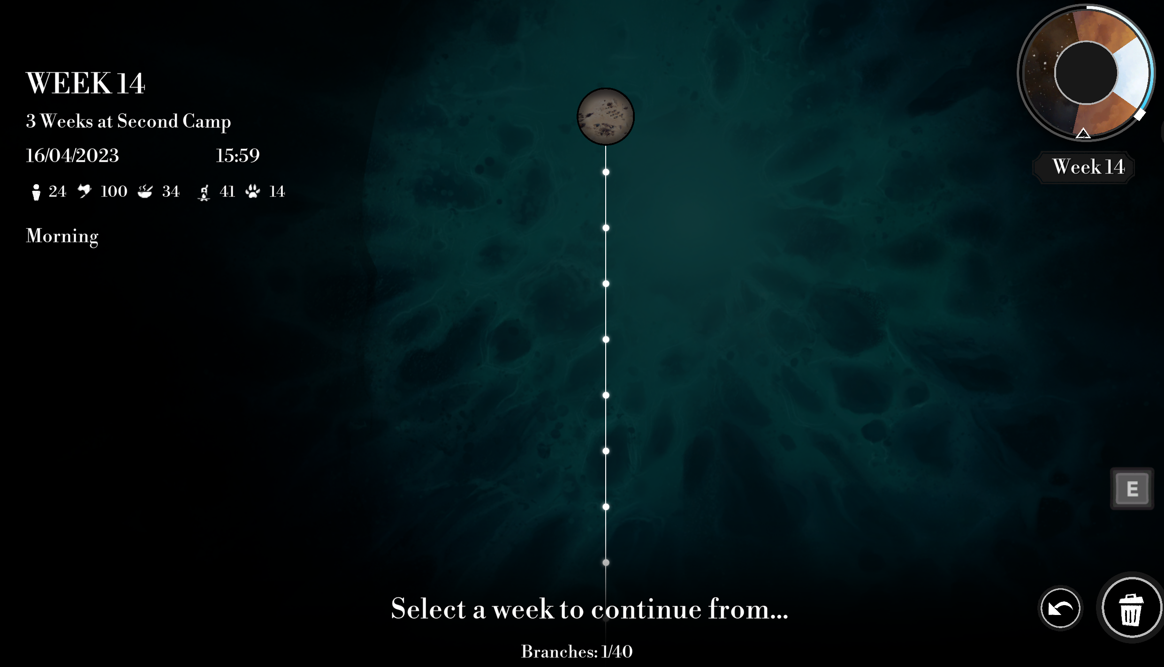
Bloom-space
(Gregg, 9)
In game screenshot self-made
Notes:
Affect is angled depending on how we enter a situation. And the situation itself might also already be angled.

Slide 17
Session 2: Mechanics of The World

Slide 18
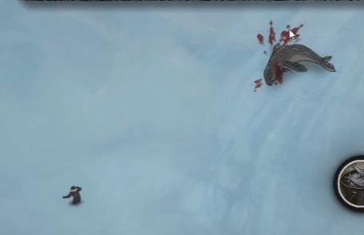
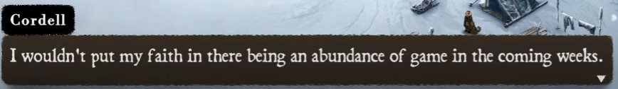
The world knows
35 weeks
12 weeks of reserve
In game screenshots self-made

Slide 19
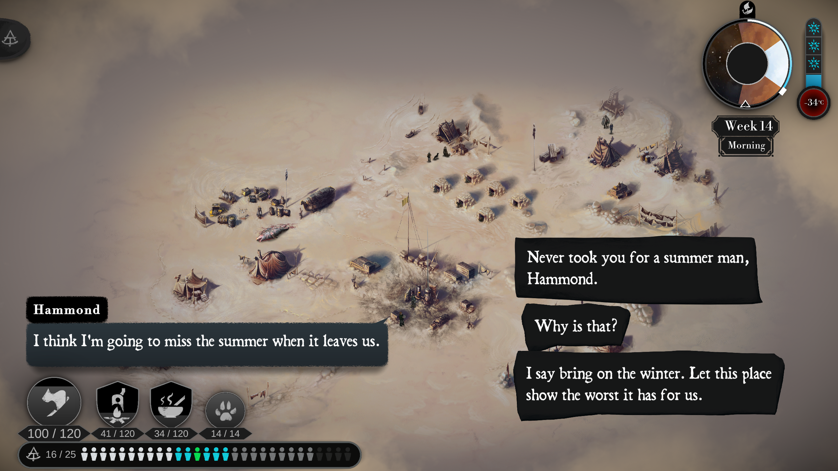
Importance of choice
IT MATTERS!
The response is specific and important
Positive
Negative
In game screenshot self-made

Slide 20
Do exciting mechanics enhance the affective relationship towards games and their narrative?

Slide 21
Ludonarrative resonance (Watssman 2012, n.p.)
As opposed to Ludonarrative dissonance (Hocking 2007, n.p.)

Slide 22
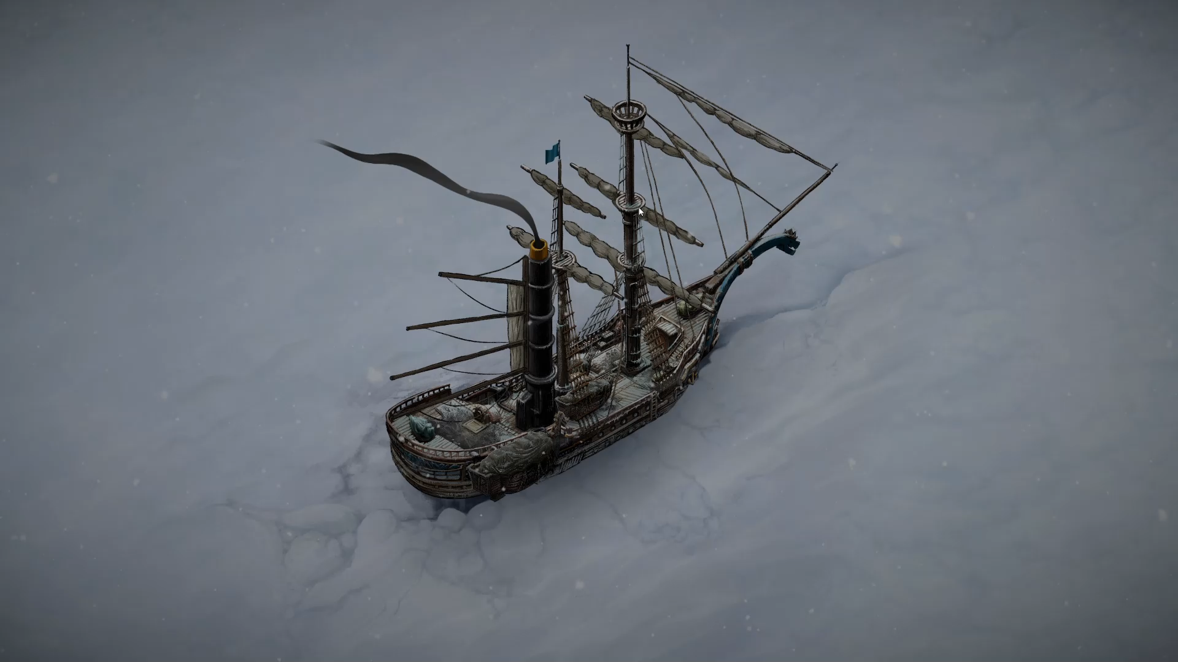

Slide 23
Session 3: Death

Slide 24
Should death be part of a narrative game?

Slide 25
Death made me like The Pale Beyond
Risk
Reward
Tension Excitement
Purpose
Affect

Slide 26
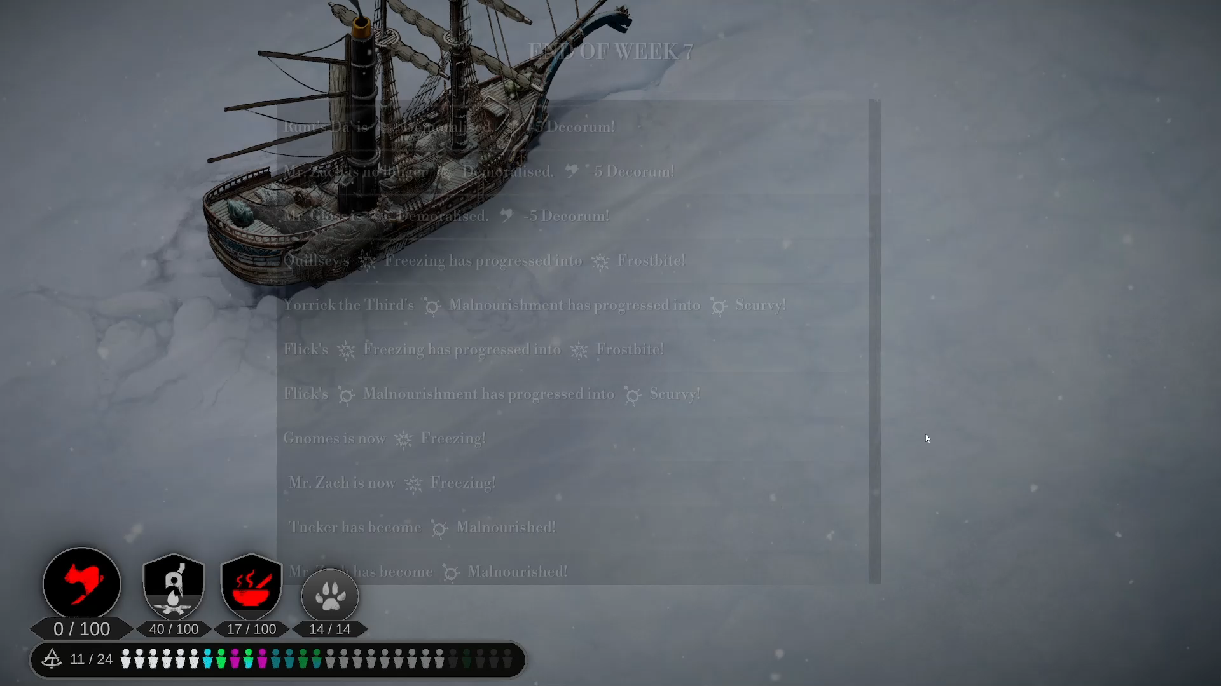

Slide 27
Session 4: Death, again

Slide 28
Mechanics of affect
In game screenshots self-made

Slide 29
How do you think you gain loyalty?
Understanding

Slide 30
“Affect is integral to body’s perpetual becoming”
The change of my understanding of Interpersonal Relationships
(Gregg, 3)

Slide 31
The change of my understanding of Interpersonal Relationships

Slide 32
Session 5: The Power of Music

Slide 33
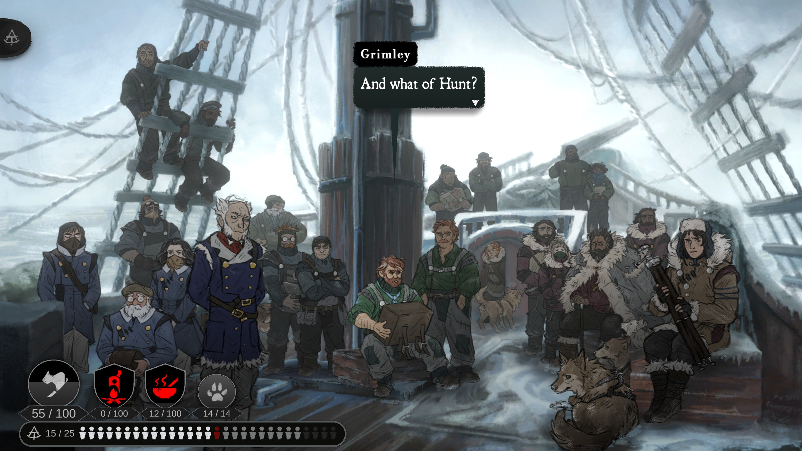
Cruel optimism
(Berlant, 1)
In game screenshot self-made
Notes:
Mass psychology

Slide 34
The Pale Beyond
Rover Vos
Image – (Bellular Studio 2023, n.p.)

Slide 35
Bibliography
Bellular Studios. 2019. The Pale Beyond. Belfast, Northern Ireland: Fellow Traveller.
Bellular Studios. 2023. The Pale Beyond Digital Artbook. Belfast, Northern Ireland: Fellow Traveller.
Gregg ,Melissa and Gregory J. Seigworth. 2010. The Affect Theory Reader. Durham, North Carolina: Duke University Press Books
Hefner, Dorothée, Christoph Klimmt and Peter Vorderer. 2007. “Identification with the Player Character as Determinant of Video Game Enjoyment”. Entertainment Computing – ICEC 2007Durham: 39-48.
Hocking, Clint. “Ludonarrative Dissonance in Bioshock.” Click Nothing. accessed April 19. 2023 https://clicknothing.typepad.com/click_nothing/2007/10/ludonarrative-d.html
Massumi, Brian. 2015. Politics of Affect. Cambridge, United Kingdom: Polity
Watssman, Jeremy. “ESSAY: LUDONARRATIVE DISSONANCE EXPLAINED AND EXPANDED.” The Escapist Magazine accessed April 19. 2023 https://forums.escapistmagazine.com/threads/essay-ludonarrative-dissonance-explained-and-expanded.110491/

